Slide 1

CERTIFICATE III IN AUTOMOTIVE REPAIR & MAINTENANCE
SUBJECT: VEHICLE MAINTENACE AND REPAIR
By Ibrahim siraj
Maldives polytechnic

Slide 2
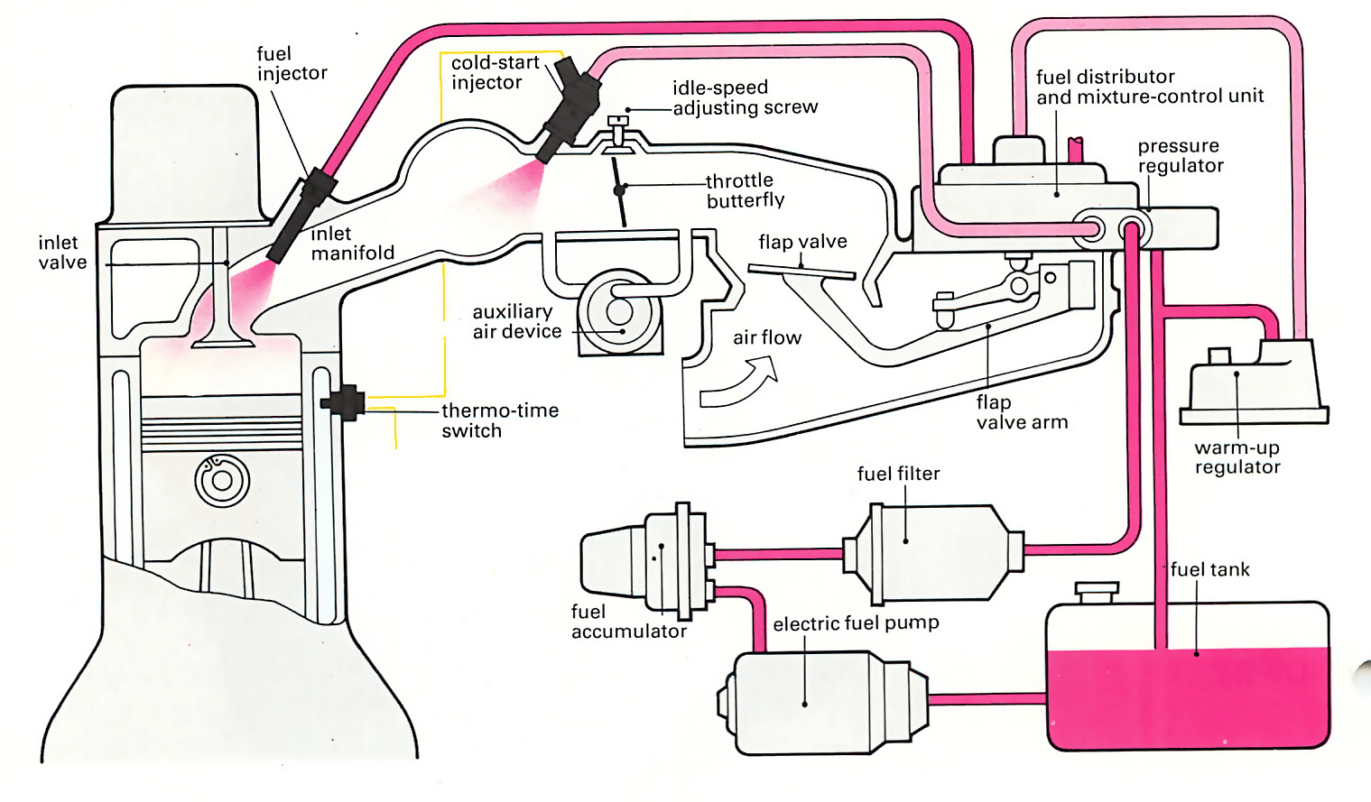
VEHICLE MAINTENACE AND REPAIR
Chapter 7 Undertake petrol fuel systems servicing
Introduction
A petrol fuel system is a system that stores and delivers fuel to an engine for combustion, consisting of a fuel tank, fuel pump, fuel lines, fuel filter, and either a carburetor (in older cars) or fuel injectors (in modern cars)
The system works by pumping fuel from the tank through filters to the carburetor or injectors, which mix it with air and deliver it to the engine's combustion chamber for power generation
By Ibrahim siraj
Maldives polytechnic

Slide 3
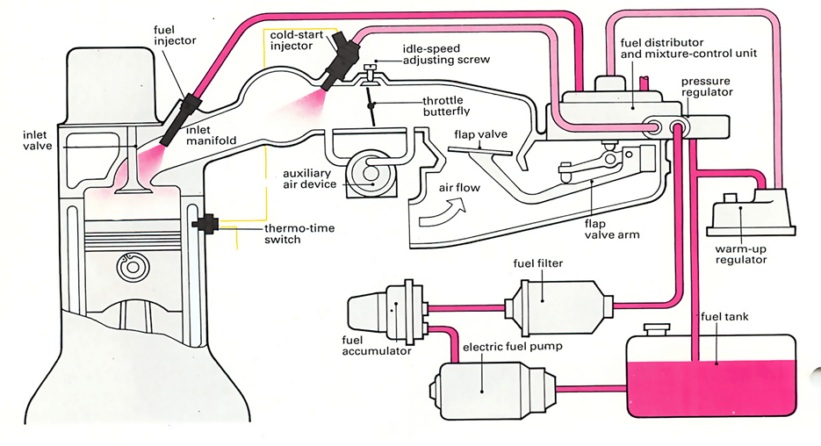
VEHICLE MAINTENACE AND REPAIR
Chapter 7 Undertake petrol fuel systems servicing
Introduction
By Ibrahim siraj
Maldives polytechnic

Slide 4
VEHICLE MAINTENACE AND REPAIR
Chapter 7 Undertake petrol fuel systems servicing
Petrol fuel components and their functions
Fuel Tank: Stores the petrol for the vehicle.
Fuel Pump: Draws fuel from the tank and pumps it under pressure through the system to the injectors.
Fuel Filter: Cleans the fuel by removing any dirt or contaminants before it reaches the engine.
Fuel Lines: A network of hoses and pipes that transport the fuel from the tank to the engine components.
Carburetor (Older Cars): Manually mixes fuel and air in the correct ratio for combustion.
Fuel Injectors (Modern Cars): Electronically controlled nozzles that spray a precise, atomized mist of fuel directly into the combustion chamber or intake manifold.
Fuel Pressure Regulator: Maintains the correct fuel pressure for the injectors to operate efficiently.
Fuel Rail: Distributes fuel from the pump to the injectors in a fuel-injected system
By Ibrahim siraj
Maldives polytechnic

Slide 5
VEHICLE MAINTENACE AND REPAIR
Chapter 7 Undertake petrol fuel systems servicing
Petrol fuel components and their functions
Fuel Tank: Stores the petrol for the vehicle.
Key components
Filler neck: The opening where fuel is inserted, designed to carry fuel into the tank and prevent spills.
Fuel cap: Seals the tank to prevent leaks and contamination.
Baffles: Internal panels that help prevent fuel from sloshing around inside the tank.
Vent pipes: Allow air to escape from the tank as it fills with fuel
By Ibrahim siraj
Maldives polytechnic

Slide 6
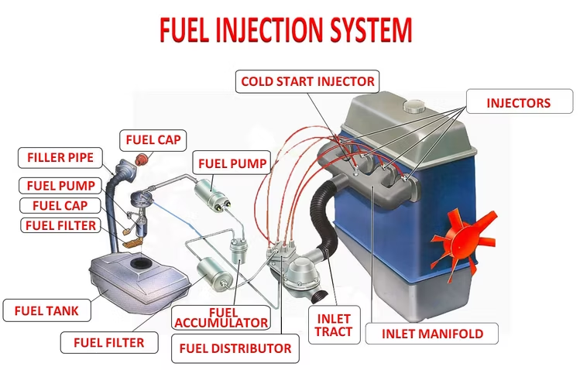
VEHICLE MAINTENACE AND REPAIR
Chapter 7 Undertake petrol fuel systems servicing
Petrol fuel components and their functions
Fuel Tank: Stores the petrol for the vehicle.
By Ibrahim siraj
Maldives polytechnic

Slide 7
VEHICLE MAINTENACE AND REPAIR
Chapter 7 Undertake petrol fuel systems servicing
Petrol fuel components and their functions
Fuel Pump: Draws fuel from the tank and pumps it under pressure through the system to the injectors.
Types of Fuel Pumps
Mechanical Fuel Pumps: Found in older, carbureted engines, these pumps are driven by the engine's camshaft or crankshaft and operate at low pressure (around 3-5 PSI).
Electric Fuel Pumps: Common in most modern, fuel-injected cars, these are powered by an electric motor and are typically located inside the fuel tank. They provide higher, more consistent pressure (50-90 PSI).
High-Pressure Fuel Pumps (Direct Injection): Used in vehicles with direct injection (GDI) systems, these pumps pressurize fuel to significantly higher levels, injecting it directly into the combustion chamber for maximum efficiency. These systems often use a low-pressure electric pump in the tank to feed the high-pressure pump on the engine
By Ibrahim siraj
Maldives polytechnic

Slide 8
VEHICLE MAINTENACE AND REPAIR
Chapter 7 Undertake petrol fuel systems servicing
Petrol fuel components and their functions
Symptoms of a Clogged Fuel Filter
Over time, the filter element becomes saturated with contaminants, restricting fuel flow and causing performance issues. Symptoms include:
Difficulty starting the engine or the engine cranking for longer than usual.
Engine stalling unexpectedly, especially when idling or under load (e.g., driving uphill).
Engine misfires or rough idling, which feels like a vibration or shaking while the car is stationary.
Loss of power or sluggish acceleration when you press the gas pedal.
Poor fuel economy, as the engine may compensate for a lean fuel mixture by burning more fuel.
Unusual noises from the fuel pump (e.g., a whining sound), as it has to work harder to push fuel through the obstruction.
The "Check Engine" light illuminating, indicating the fuel system is running lean (too much air, not enough fuel).
By Ibrahim siraj
Maldives polytechnic

Slide 9
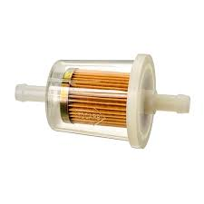
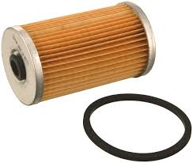
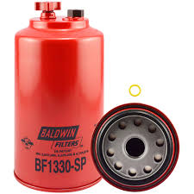
VEHICLE MAINTENACE AND REPAIR
Chapter 7 Undertake petrol fuel systems servicing
Types of Diesel Fuel Filters
Fuel filters generally fall into a few primary types based on their design and location in the fuel system.
In-line Fuel Filters: These are typically simple, disposable units installed in the fuel line itself.
Cartridge Fuel Filters: These use a replaceable filter element within a permanent housing, often with a transparent bowl and drain valve to visually inspect and remove water or impurities.
Spin-on Fuel Filters: These filters have a metal canister housing that spins onto a base on the engine or fuel system, similar to an oil filter
By Ibrahim siraj
Maldives polytechnic

Slide 10
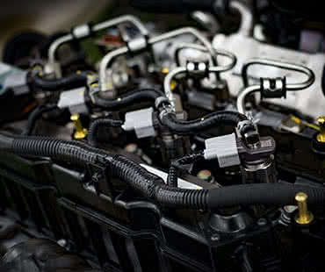
VEHICLE MAINTENACE AND REPAIR
Chapter 7 Undertake petrol fuel systems servicing
Petrol fuel components and their functions
Fuel Lines: A network of hoses and pipes that transport the fuel from the tank to the engine components.
Petrol fuel lines in a car are pipes or hoses that carry fuel from the tank to the engine, ensuring a steady and clean supply for combustion
By Ibrahim siraj
Maldives polytechnic

Slide 11
VEHICLE MAINTENACE AND REPAIR
Chapter 7 Undertake petrol fuel systems servicing
Types of fuel delivery system
Modern petrol engines primarily use various forms of fuel injection, which offers better precision than older systems like gravity or basic pump-carburetor systems
Single-Point Injection (Throttle Body Injection): An early form of injection that uses one or two injectors in the throttle body, similar to a carburetor setup. It was a simple transition from carburetors but less precise than newer methods.
Multi-Point Injection (Port Injection): Uses a separate injector for each cylinder, located just upstream of the intake valve. This allows for more even fuel distribution and better control of the air-fuel ratio than single-point injection.
Sequential Fuel Injection: An advancement of multi-point injection where the fuel is injected in precise timing with each cylinder's intake stroke, further improving efficiency and reducing emissions.
By Ibrahim siraj
Maldives polytechnic

Slide 12
VEHICLE MAINTENACE AND REPAIR
Chapter 7 Undertake petrol fuel systems servicing
Types of fuel delivery system
Modern petrol engines primarily use various forms of fuel injection, which offers better precision than older systems like gravity or basic pump-carburetor systems
Direct Injection (Gasoline Direct Injection - GDI): The most advanced system, injecting high-pressure fuel directly into the combustion chamber. This provides maximum precision in fuel metering, leading to improved power output, better fuel economy, and lower emissions.
By Ibrahim siraj
Maldives polytechnic

Slide 13
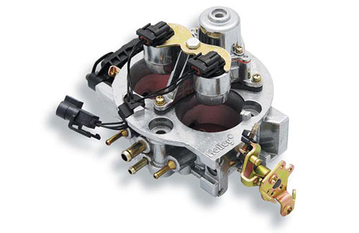
VEHICLE MAINTENACE AND REPAIR
Chapter 7 Undertake petrol fuel systems servicing
Types of fuel delivery system
Modern petrol engines primarily use various forms of fuel injection, which offers better precision than older systems like gravity or basic pump-carburetor systems
Single-Point Injection (Throttle Body Injection): An early form of injection that uses one or two injectors in the throttle body, similar to a carburetor setup. It was a simple transition from carburetors but less precise than newer methods.
By Ibrahim siraj
Maldives polytechnic

Slide 14
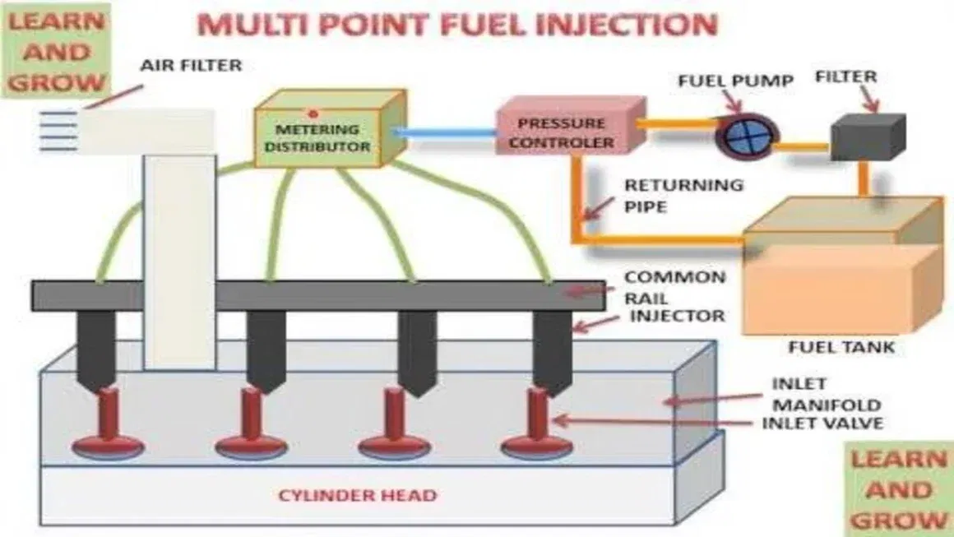
VEHICLE MAINTENACE AND REPAIR
Chapter 7 Undertake petrol fuel systems servicing
Types of fuel delivery system
Modern petrol engines primarily use various forms of fuel injection, which offers better precision than older systems like gravity or basic pump-carburetor systems
Multi-Point Injection (Port Injection): Uses a separate injector for each cylinder, located just upstream of the intake valve. This allows for more even fuel distribution and better control of the air-fuel ratio than single-point injection.
By Ibrahim siraj
Maldives polytechnic

Slide 15
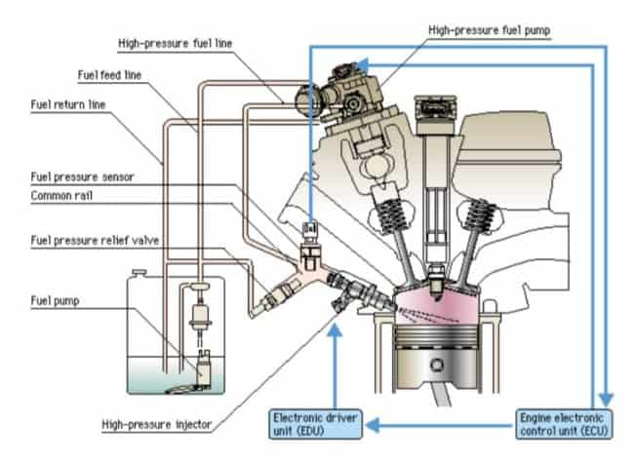
VEHICLE MAINTENACE AND REPAIR
Chapter 7 Undertake petrol fuel systems servicing
Types of fuel delivery system
Modern petrol engines primarily use various forms of fuel injection, which offers better precision than older systems like gravity or basic pump-carburetor systems
Direct Injection (Gasoline Direct Injection - GDI): The most advanced system, injecting high-pressure fuel directly into the combustion chamber. This provides maximum precision in fuel metering, leading to improved power output, better fuel economy, and lower emissions.
By Ibrahim siraj
Maldives polytechnic

Slide 16
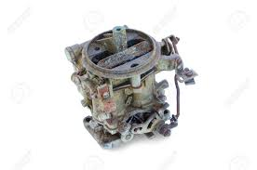
VEHICLE MAINTENACE AND REPAIR
Chapter 7 Undertake petrol fuel systems servicing
Petrol fuel components and their functions
Carburetor (Older Cars): Manually mixes fuel and air in the correct ratio for combustion.
Key Components
Float Chamber (Bowl): A small reservoir that holds a constant supply of fuel, regulated by a float and needle valve mechanism to prevent overflowing.
Venturi: The constricted passage that increases air velocity and lowers pressure to draw in fuel.
Jets: Precisely sized orifices (including main jets and idle jets) that control the flow rate of fuel into the air mixture at different engine speeds and loads.
Choke Valve: Located at the top of the carburetor, it restricts airflow during a cold start to create a fuel-rich mixture, which is easier to ignite when the engine is cold.
Throttle Valve (Plate): A butterfly valve located below the venturi, connected to the accelerator pedal. It controls the amount of the air-fuel mixture entering the engine, thus regulating engine power and speed.
By Ibrahim siraj
Maldives polytechnic

Slide 17
THANK YOU

